Slide 1


Predict Clicked Ads Customer Classification by using Machine Learning
Created by:
Lana Fuadi
Gmail | LinkedIn | GitHub | Medium
“I am a results-driven data scientist with a passion for leveraging data to drive business success. Through rigorous training at Rakamin Bootcamp, I have honed my skills in Python, ML, SQL, and Business Intelligence. I am committed to continuous learning and have completed additional certifications and course to further enhance my expertise. With strong collaboration, critical thinking, and problem solving skills, I am confident in my ability to help your company make data-driven decisions that propel your business to new heights.”

Slide 2
Overview
“Sebuah perusahaan di Indonesia ingin mengetahui efektifitas sebuah iklan yang mereka tayangkan, hal ini penting bagi perusahaan agar dapat mengetahui seberapa besar ketercapainnya iklan yang dipasarkan sehingga dapat menarik customers untuk melihat iklan.
Dengan mengolah data historical advertisement serta menemukan insight serta pola yang terjadi, maka dapat membantu perusahaan dalam menentukan target marketing, fokus case ini adalah membuat model machine learning classification yang berfungsi menentukan target customers yang tepat ”

Slide 3
EXPLORATORY DATA ANALYSIS
STATISTICAL ANALYSIS
The users have ages ranging from 19 years to 61 years, while the average age of the users is 35 years.
The average income of the users is 384.864.670,64.
On average, the users spend 180 minutes per day on the internet.
On average, the users spend 65 minutes per day on the site.
The most frequent gender is 'Perempuan' (female) that appears 518 times out of 997, which slightly higher compare to male.
Click On Ad has balance distribution, with 500 'No' and 500 'Yes'.
'Surabaya' is the most frequently occuring in City, which appears 64 times.
'DKI Jakarta' is the most frequently occuring in Province, which appears 253 times.
The most frequently occcuring category is 'Otomotif' (Automotive), which appears 112 times.

Slide 4
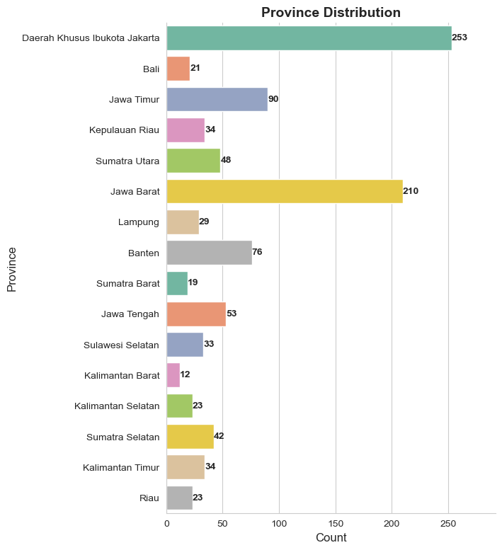
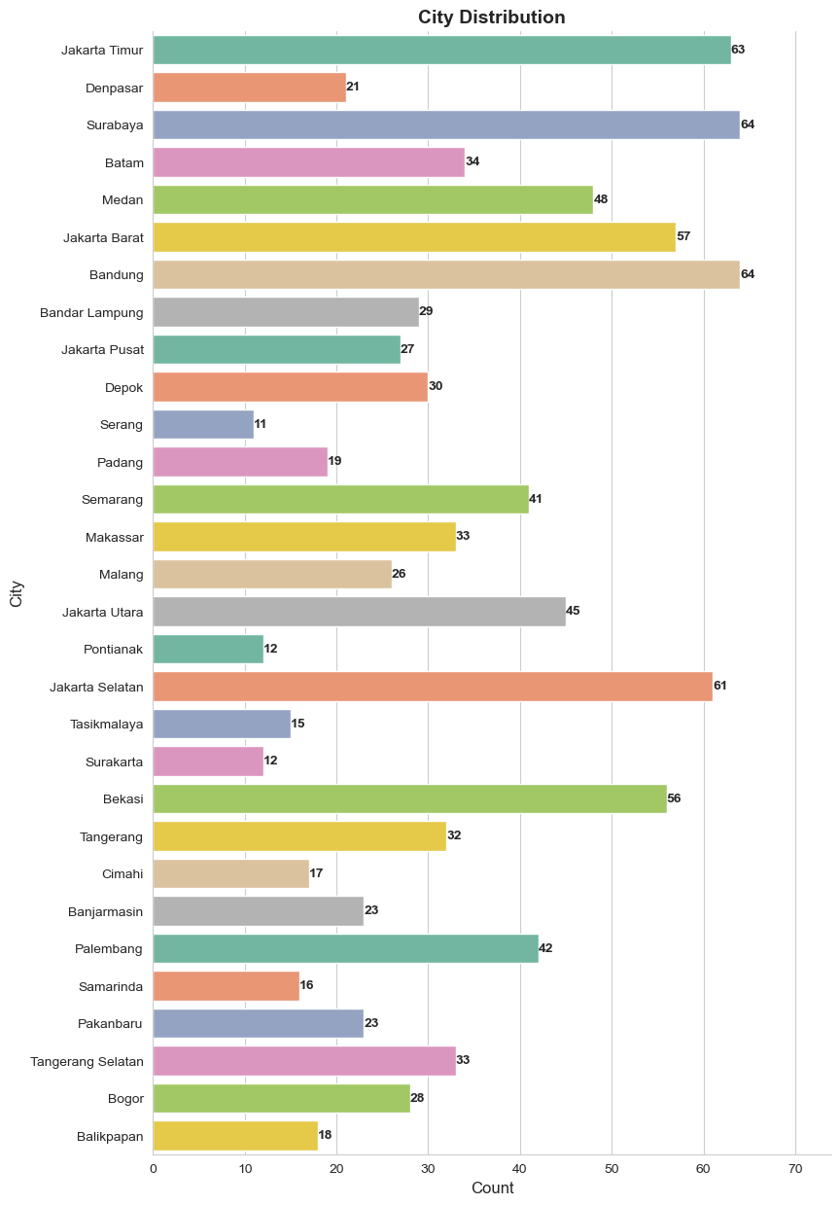
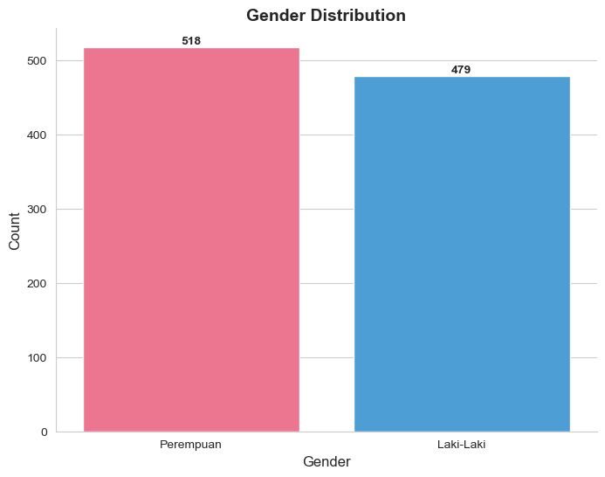
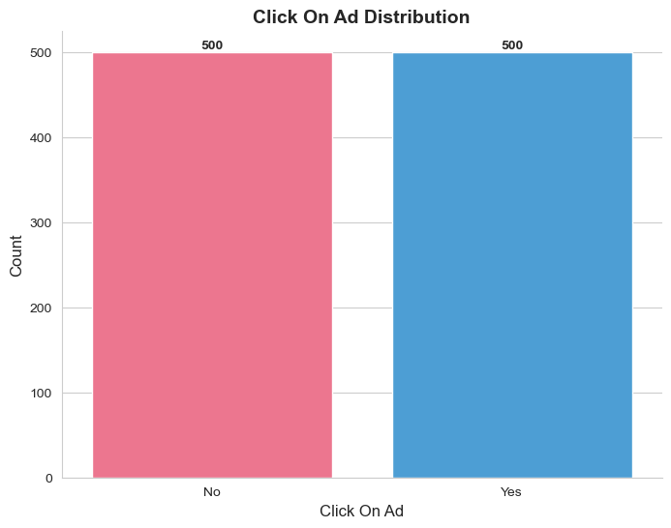
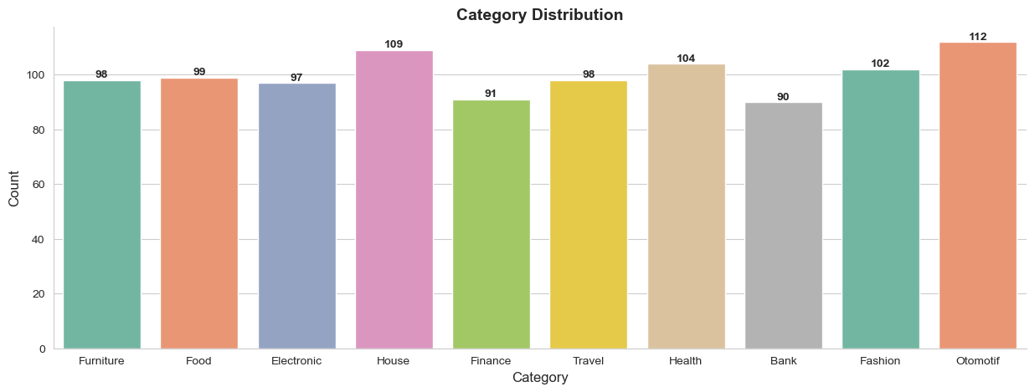
EXPLORATORY DATA ANALYSIS
Univariate Analysis

Slide 5
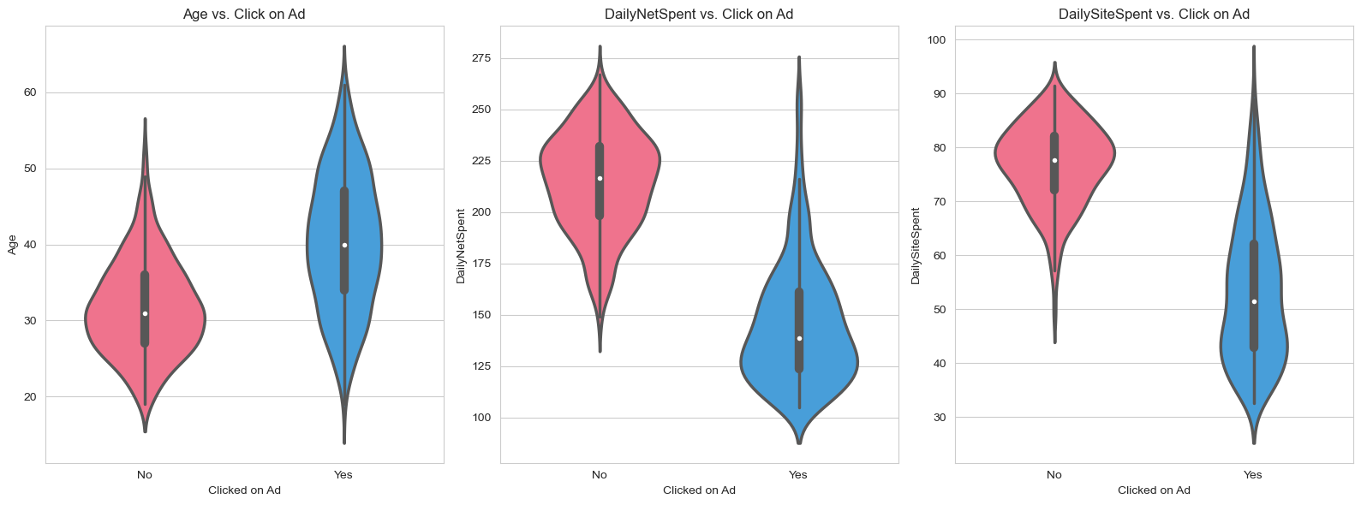
EXPLORATORY DATA ANALYSIS
Bivariate Analysis

Slide 6
EXPLORATORY DATA ANALYSIS
Statistical Analysis
1. Age
the density of no is highest around age of 30, indicating that users in their 30s are less likely to click on ads.
the density of yes is highest around age of 40, indicating that users in their 40s are more likely to click on ads.
no distribution appears wider and shorter, indicating that it has a higher density and lower variablity.
yes distribution appears slimer and longer, indicating that it has a lower density and higher variability.
no distribution has a longer tail towards higher ages, indicating that it has a positive skew and has outlier.
2. DailyNetSpent
the density of no is highest around minutes of 225, indicating that users who has daily spent around 225 minutes on internet are less likely to click on ads.
the density of yes is highest around minutes of 125, indicating that users who has daily spent around 125 minutes on internet are more likely to click on ads.
no distribution appears shorter, indicating that it has a lower variablity.
yes distribution appears longer, indicating that it has a higher variability.
no distribution has a longer tail towards lower minutes, indicating that it has a negative skew and has outlier.
yes distribution has a very long tail towards higher minutes, indicating that it has a high positive skew and has outlier.
3. DailySiteSpent
the density of no is highest around minutes of 79, indicating that users who has daily spent around 79 minutes on internet are less likely to click on ads.
the density of yes is highest around minutes of 42, indicating that users who has daily spent around 42 minutes on internet are more likely to click on ads.
no distribution appears wider and shorter, indicating that it has a higher density and lower variablity.
yes distribution appears slimer and longer, indicating that it has a lower density and higher variability.
no distribution has a longer tail towards lower minutes, indicating that it has a negative skew and has outlier.
yes distribution has a longer tail towards higher minutes, indicating that it has a positive skew and has outlier.

Slide 7
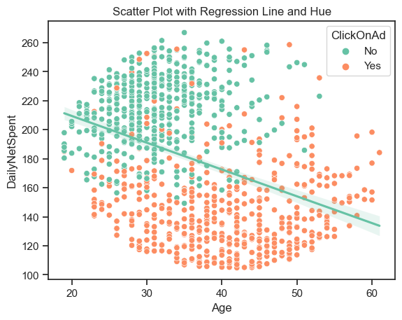
EXPLORATORY DATA ANALYSIS
Multivariate Analysis
The scatter plot appears that there is a higher concentration of green points in the upper left part of the plot (lower age values and higher daily internet spending), indicating that the younger users who spend more minutes on the internet tend not to click on ads.
On the other hand, the orange points seem to be more spread out across the plot, indicating that older users who spend more minutes on the internet or younger users tend to click on ads.
The regression line is higher on the left and lower in the right side of the plot, indicating a negative relationship between age and daily internet spending. it means as age increases, daily internet spending tends to decrease.

Slide 8
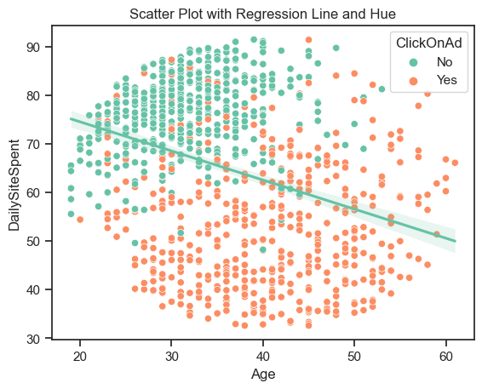
EXPLORATORY DATA ANALYSIS
Multivariate Analysis
The scatter plot appears that there is a higher concentration of green points in the upper left part of the plot (lower age values and higher daily internet spending), indicating that the younger users who spend more minutes on the site tend not to click on ads.
On the other hand, the orange points seem to be more spread out across the plot, indicating that older users who spend more minutes on the site or younger users tend to click on ads.
The regression line is higher on the left and lower in the right side of the plot, indicating a negative relationship between age and daily site spending. it means as age increases, daily site spending tends to decrease.

Slide 9
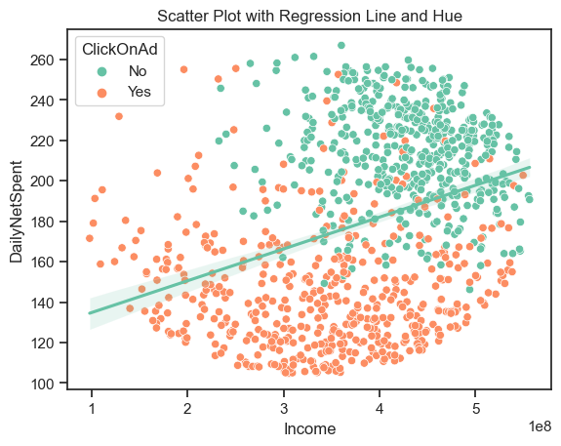
EXPLORATORY DATA ANALYSIS
Multivariate Analysis
The scatter plot appears that there is a higher concentration of green points in the upper right part of the plot (higher income values and higher daily internet spending), indicating that the higher income users who spend more minutes on the internet tend not to click on ads.
On the other hand, the orange points seem to be more spread out across the plot, indicating that higher income users who spend more minutes on the internet or lower income users tend to click on ads.
The regression line is lower on the left and higher in the right side of the plot, indicating a positive relationship between income and daily site spending. it means as income increases, daily internet spending tends to increase.

Slide 10
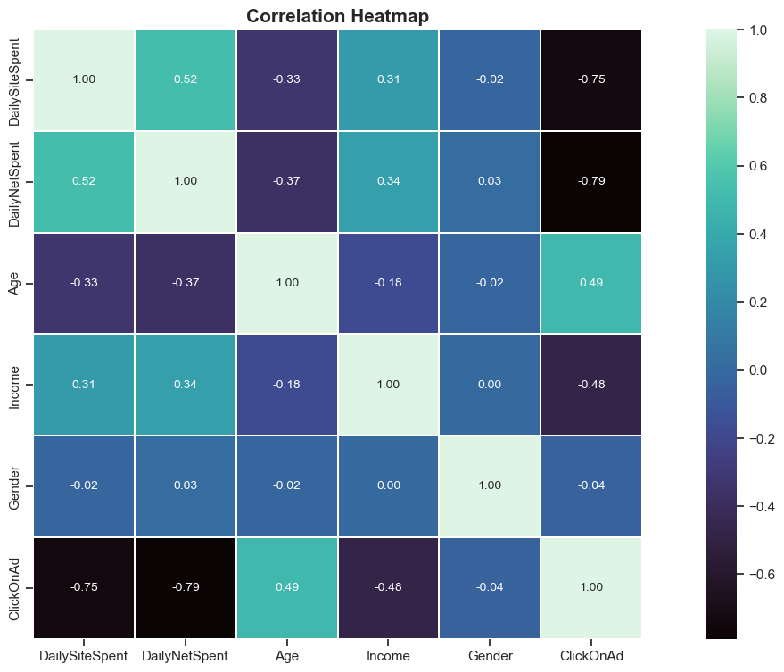
EXPLORATORY DATA ANALYSIS
Correlation Heatmap
No multicollinearity found on the correlation heatmap.
DailySiteSpent and DailyNetSpent has high negative correlation to ClickOnAd, indicating that as DailyNetSpent or DailySiteSpent increases, users tend to click on ad.
Age has positive correlation to ClickOnAd, indicating that older users are more likely to click on ad.
Income has negative correlation to ClickOnAd, indicating that higher income users are less likely to click on ad.
Gender has no significant correlation to ClickOnAd.

Slide 11
THANK YOU
More detail is in here

